Slide 1
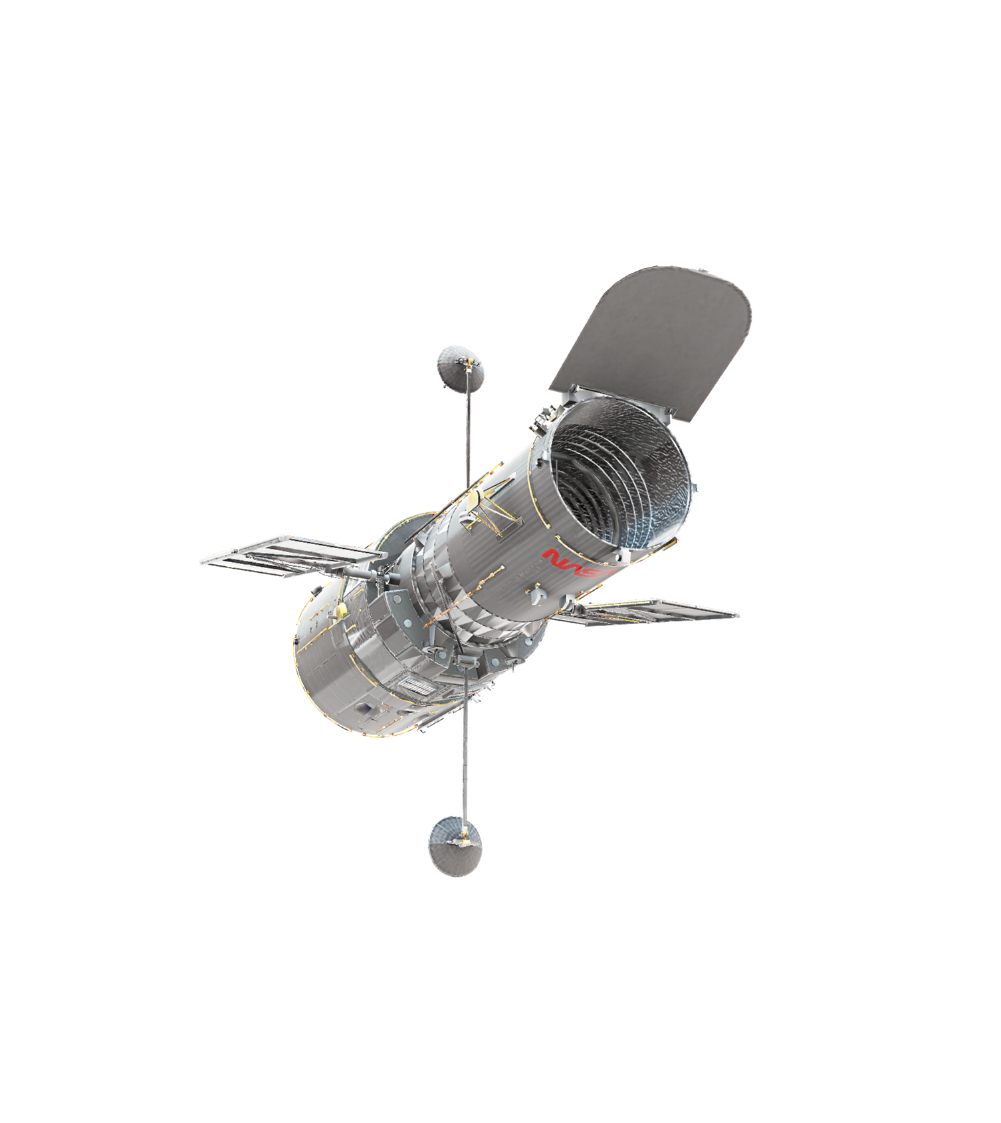
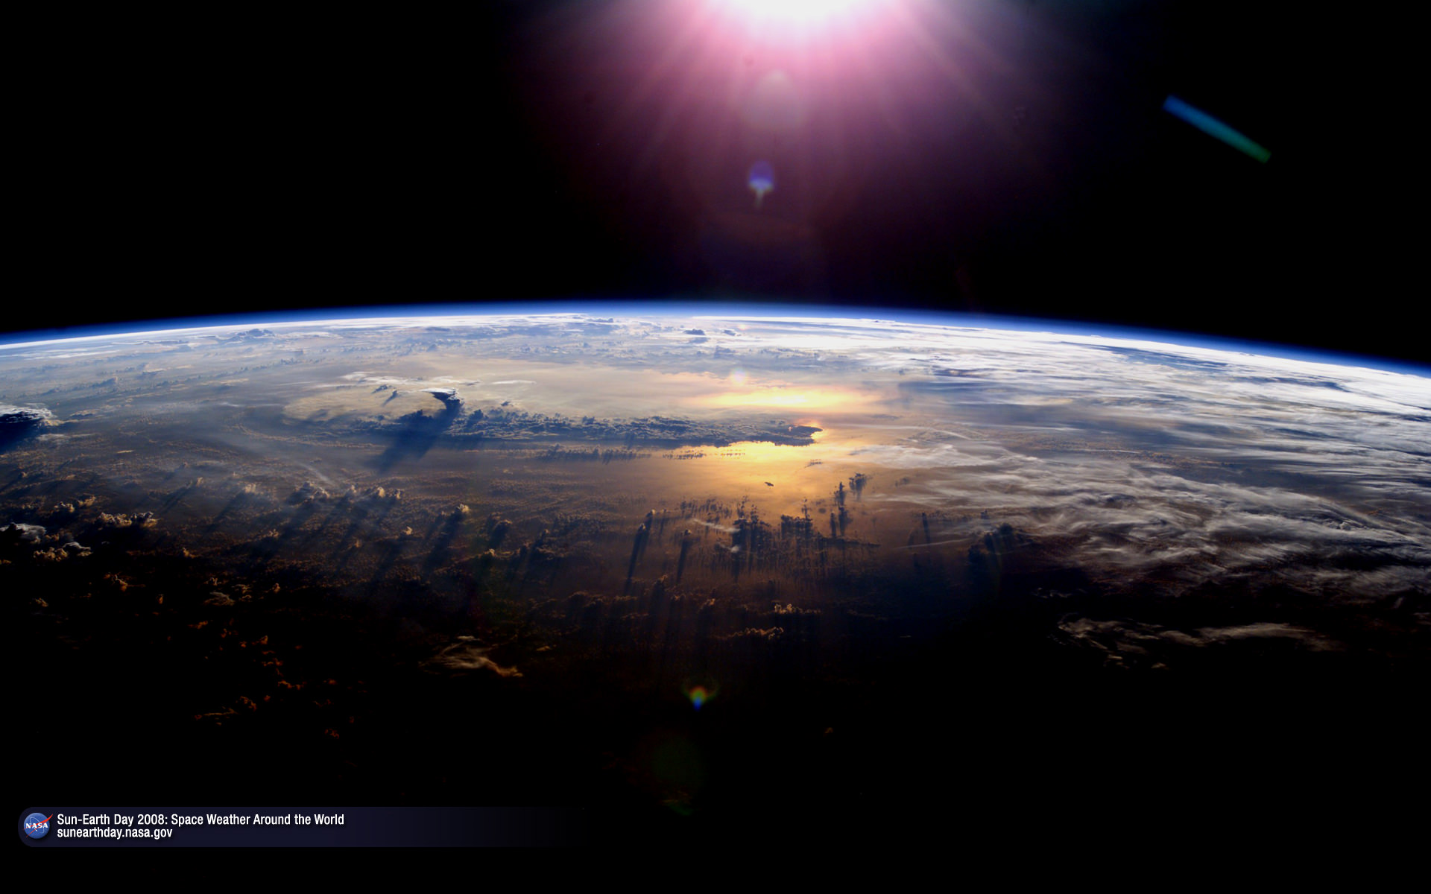
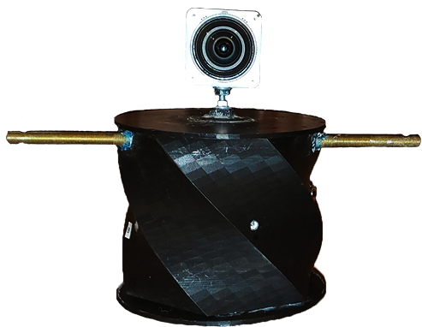
Pima Community College NASA Ascend 2020
Pima’s Team:
Quynn Bell, Zach Moir, Maximo Esquivel, Andres Zavala
Briana Pomales, Nathan Vandivort, Michelle Burr, Estaven Cleveland

Slide 2
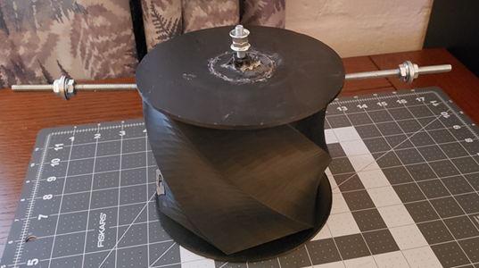
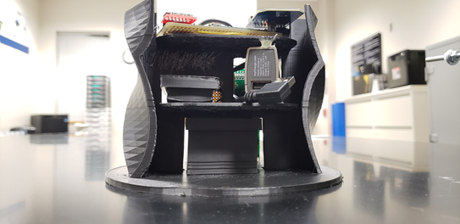
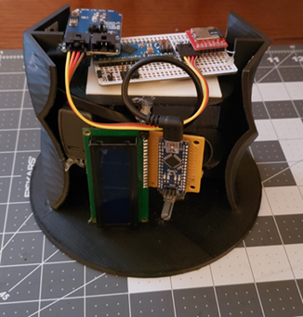
PAYLOAD ISSUES
Our team decided to reuse last semester’s payload but had to fix issues noticed during the 2019 launch. These issues include:
- Battery low current shut off
- Temperature sensor not reading negative values
- No way to turn payload on or off from outside.
Last Semester’s Payload
Payload Inside
Payload Electronics

Slide 3
OBJECTIVES
Payload capable of measuring altitude, pressure, temperature, and light.
Study effects of low atmospheric environments on moss samples.
Effects of Ionizing Radiation on Culex Pipiens (Mosquito Larvae)
[INSERT TEAM PHOTO HERE]

Slide 4
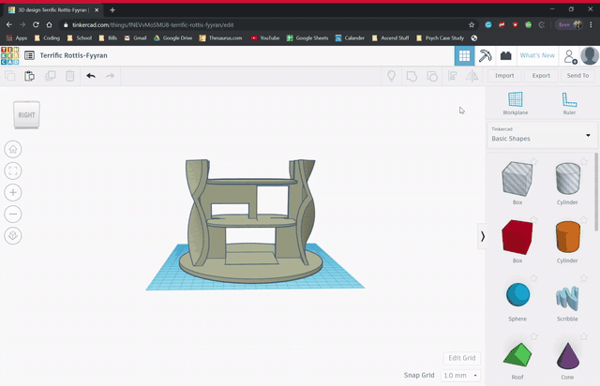
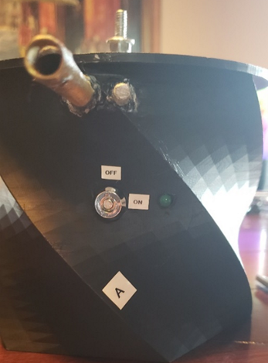
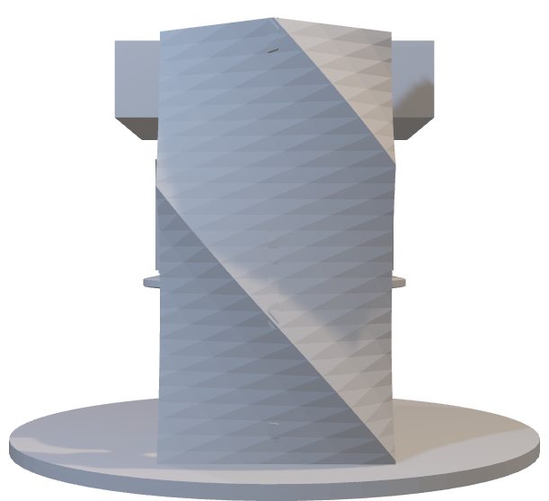
PAYLOAD DESIGN
In order to fix the issues, our team added:
back up temperature sensors
replaced the battery
-added a key switch to the outside
After the design was fixed, our team decided to add light sensors and a geiger counter to collect data that will be helpful to the moss study.
Designing our payload insides
Keyswitch and Signal LED
Payload Electronics
Mosquito
Larvae
Battery
Moss

Slide 5
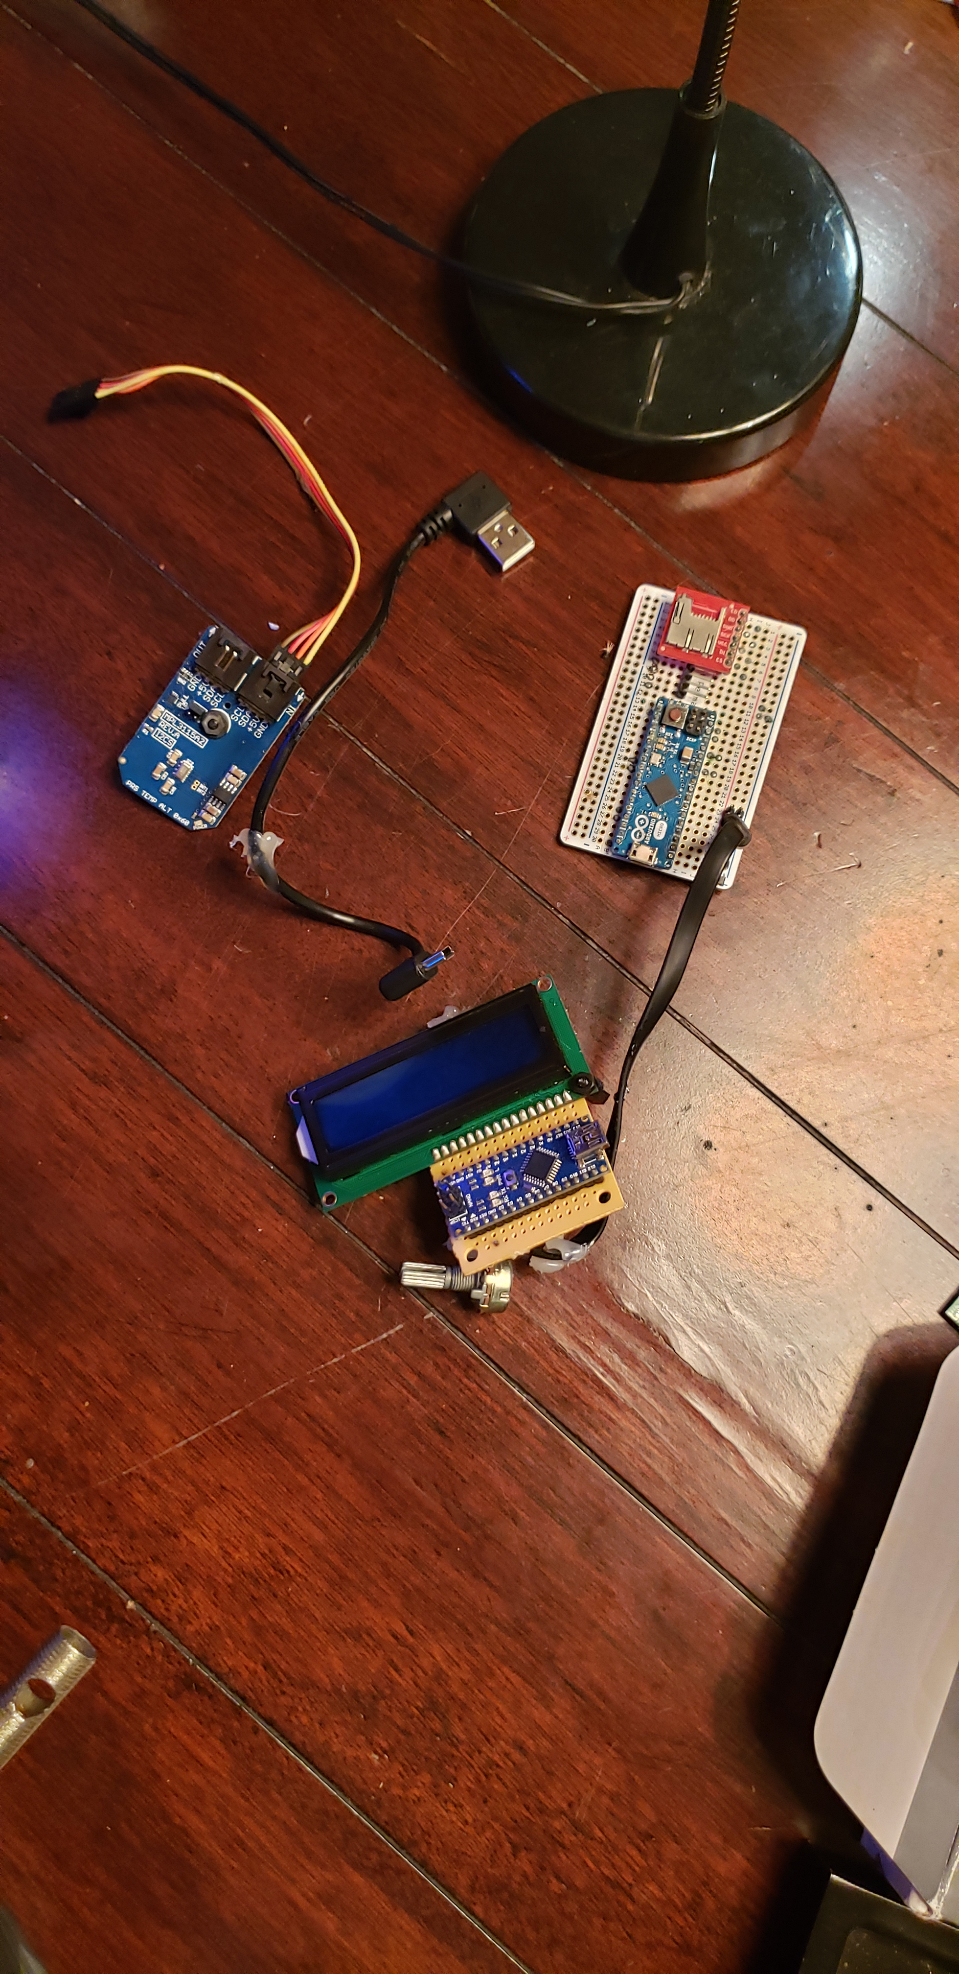
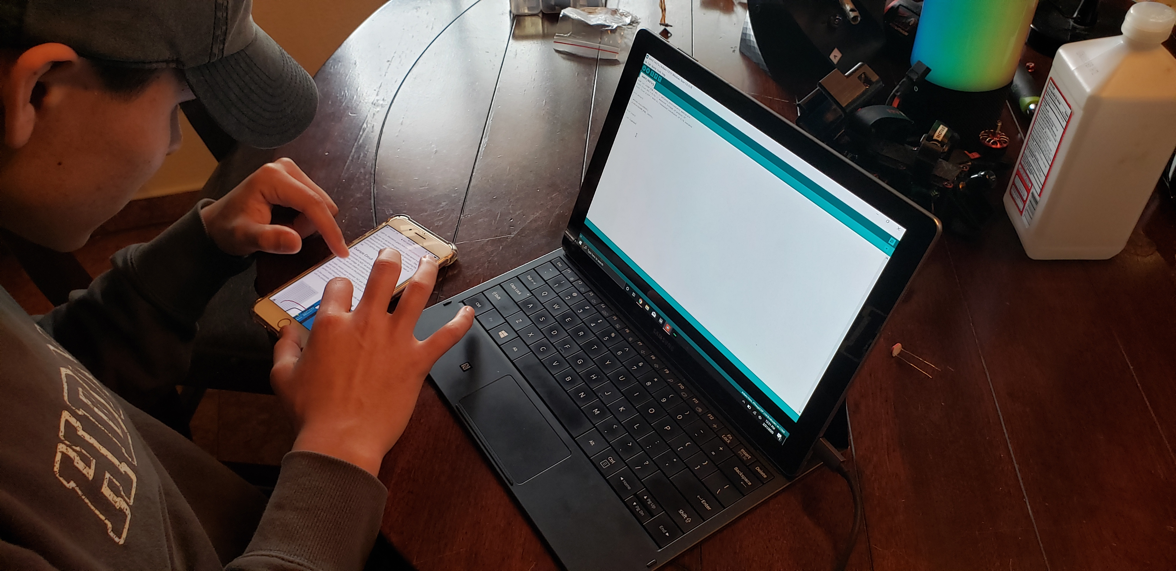
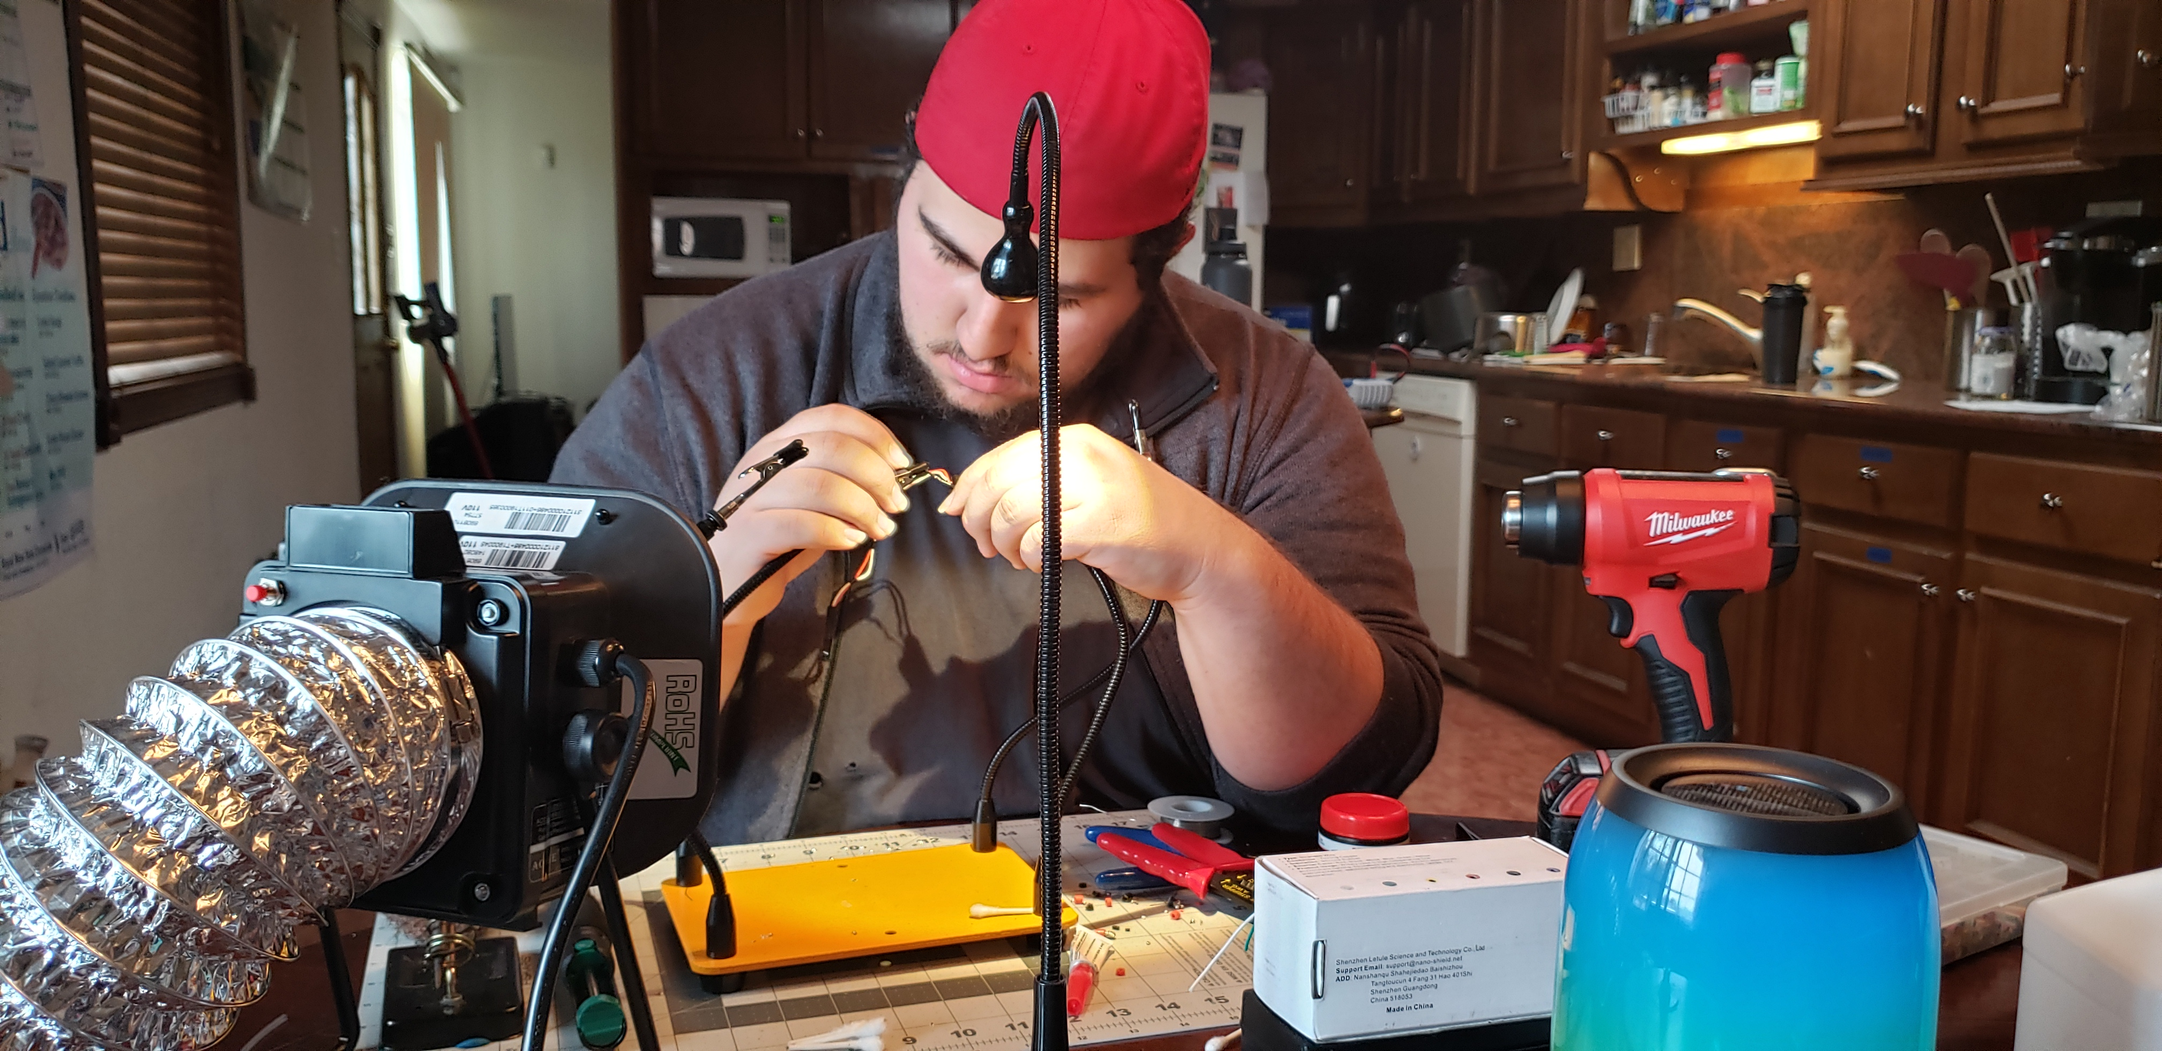
PAYLOAD BUILD PROCESS
Since the previous semester’s payload handled the launch so well, our team decided to reuse the payload. This allowed us to spend more time correcting issues and adding new sensors to the payload.
Tearing down last semester’s electronics
Maximo doing some of the coding for the light sensors
Andres soldering some electronic components

Slide 6
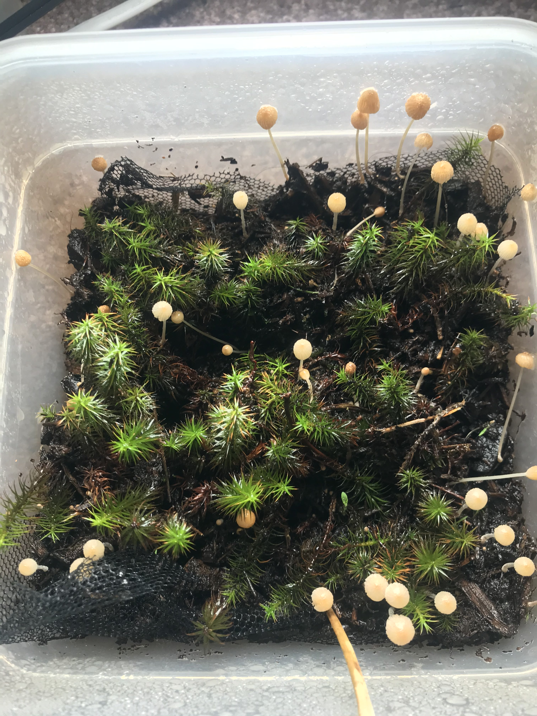
MOSS STUDY by Nathan, Briana, and Andres
Our team was interested in the effects of low atmospheric environments on moss samples. This idea was inspired by research from Cambridge University that theorizes the use of moss as a renewable biomaterial for extra-planetary colonies.
Last year we studied the effects of moss as it is exposed at varying levels to the outer atmosphere and attempted to re-cultivate our samples back on the ground.
This year, our focus was on seeing how factors such as radiation and temperature from the outer atmosphere can affect moss samples.
Most recent photo of moss; taken 04/06/2020

Slide 7
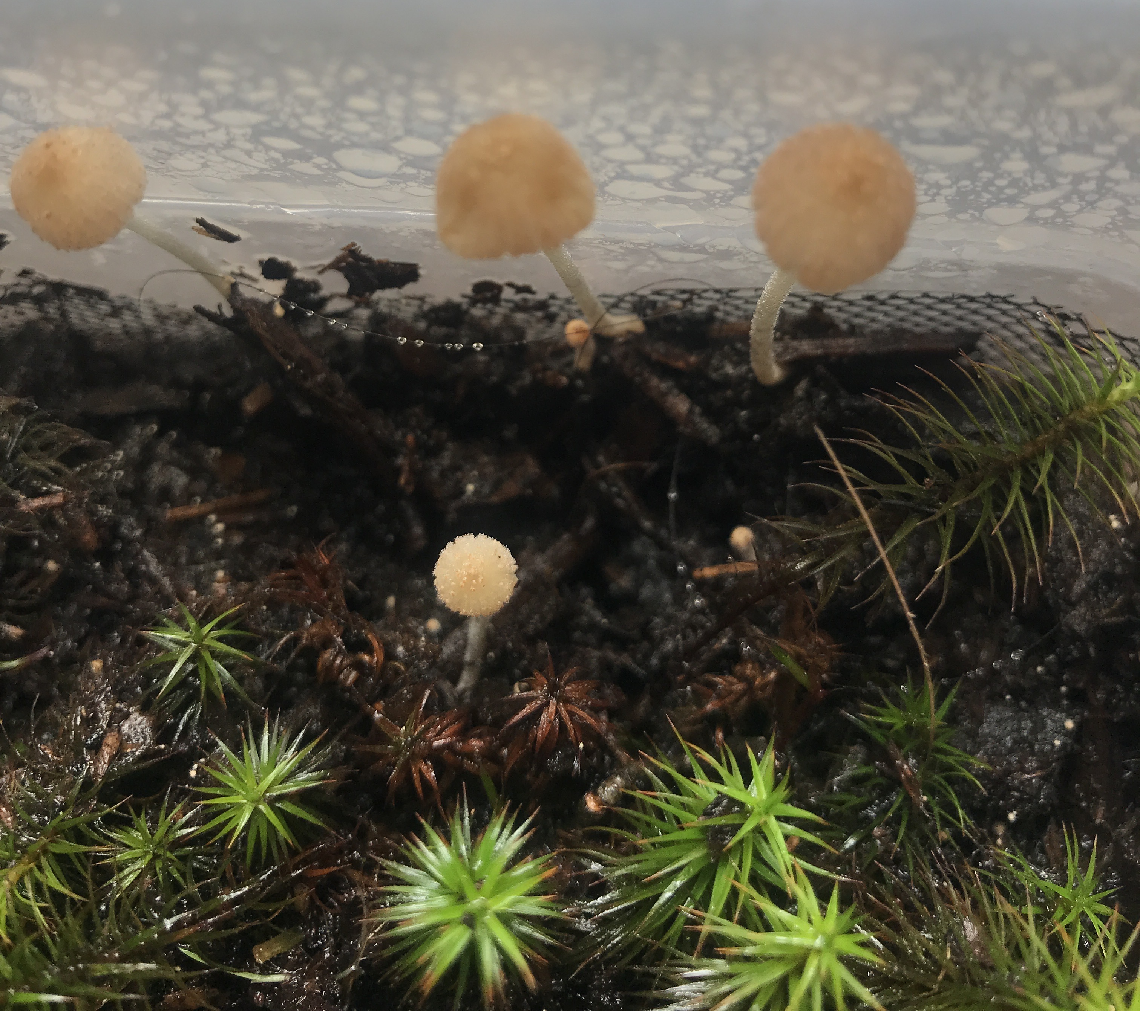
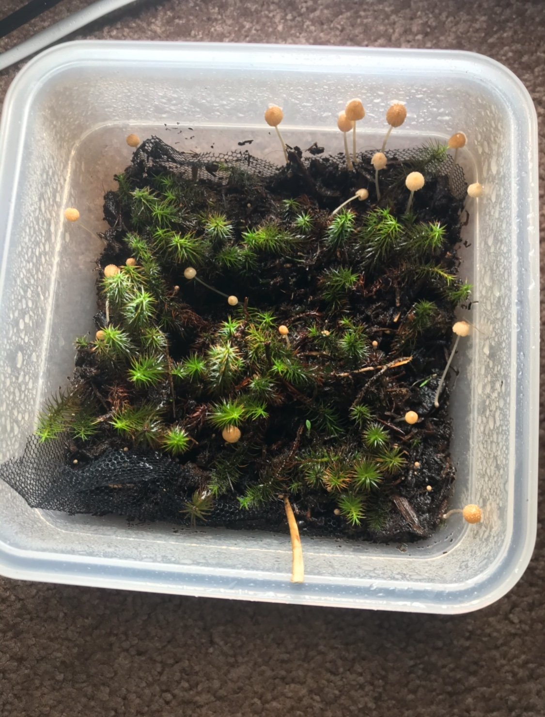
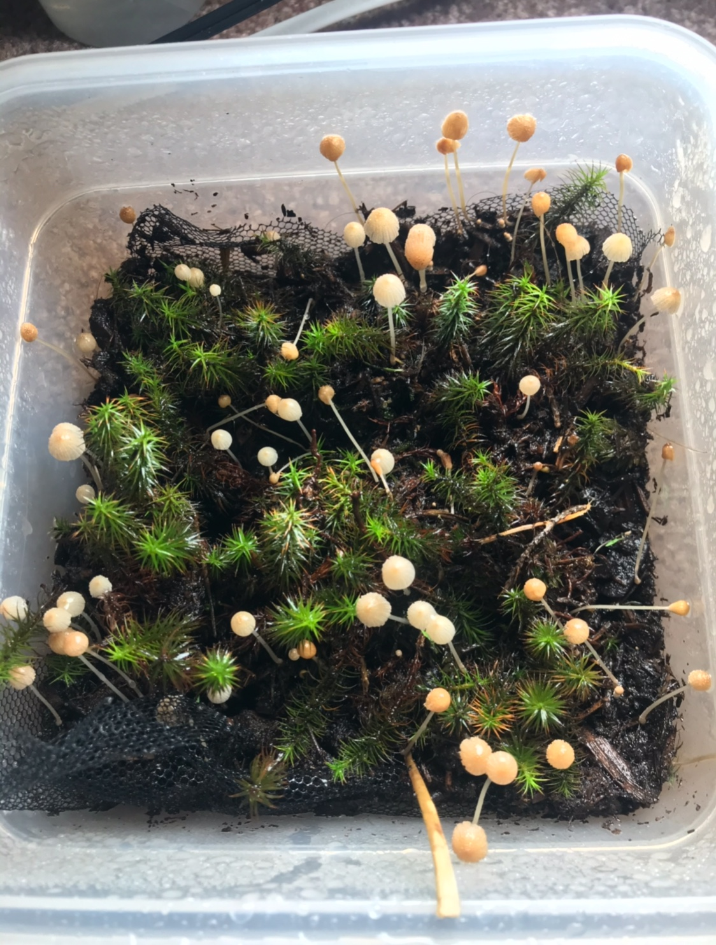
MOSS STUDY continued
For cultivating the moss, our team noticed it was difficult to get the haircap moss to blossom. Although the initial sample was unaffected, our team was able to get new capsules to grow, but they would not mature and inevitably ended up dying. Our team predicts that after the launch radiation, temperature, or pressure fluctuations from the launch will affect the moss’s ability to grow. These predictions remain independent from the initial result demonstrated during the initial cultivation.
1 week after cultivating
2 weeks after cultivating moss
3 weeks after cultivating moss

Slide 8
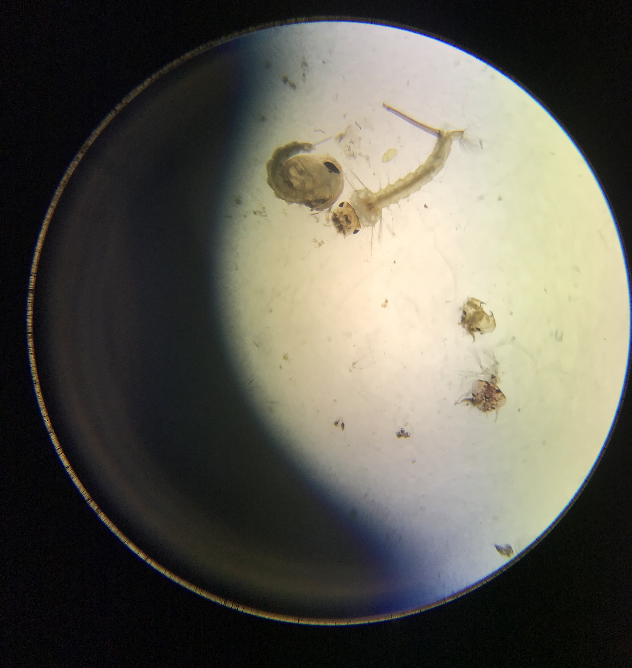
MOSQUITO STUDY by Estevan
The purpose of this study is to observe the effects of Ionizing radiation on the species of mosquitoes, Culex Pipiens. What and if there will be any changes on protein expressions. whether or not the cells will have gone through a respiration period and division. Division otherwise known as mitosis is key for genetic differentiation, will the cells undergo mitosis while absorbing the Ionizing Radiation. If they did, how will it affect the genetic material? However in order to determine these outcomes a reverse transcription would be the only method of observing genetic damage through protein expressions.
Above we observe at 400x magnification a Mosquito Larvae (right) and a mosquito pupae (left). Mosquitos have more proteins at the larval stage than at any other state (insert cite), For this reason we utilized only mosquitos at the larval stage.

Slide 9
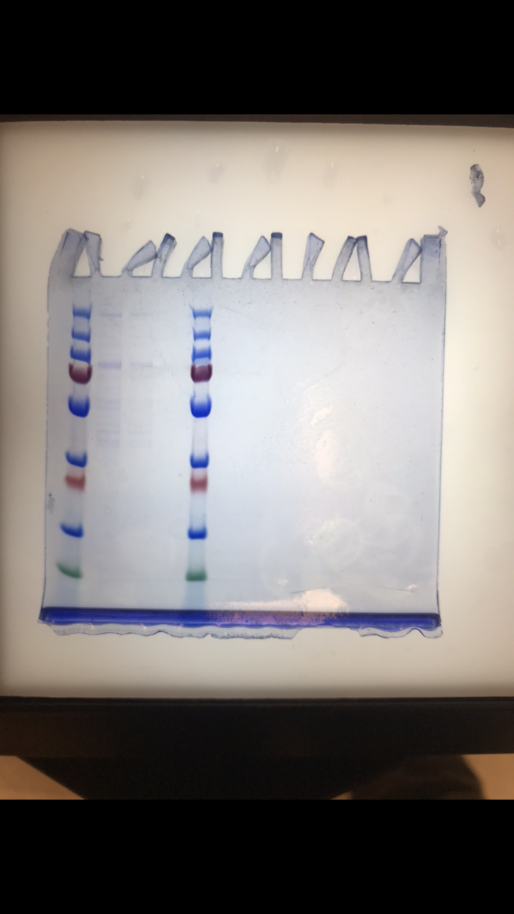
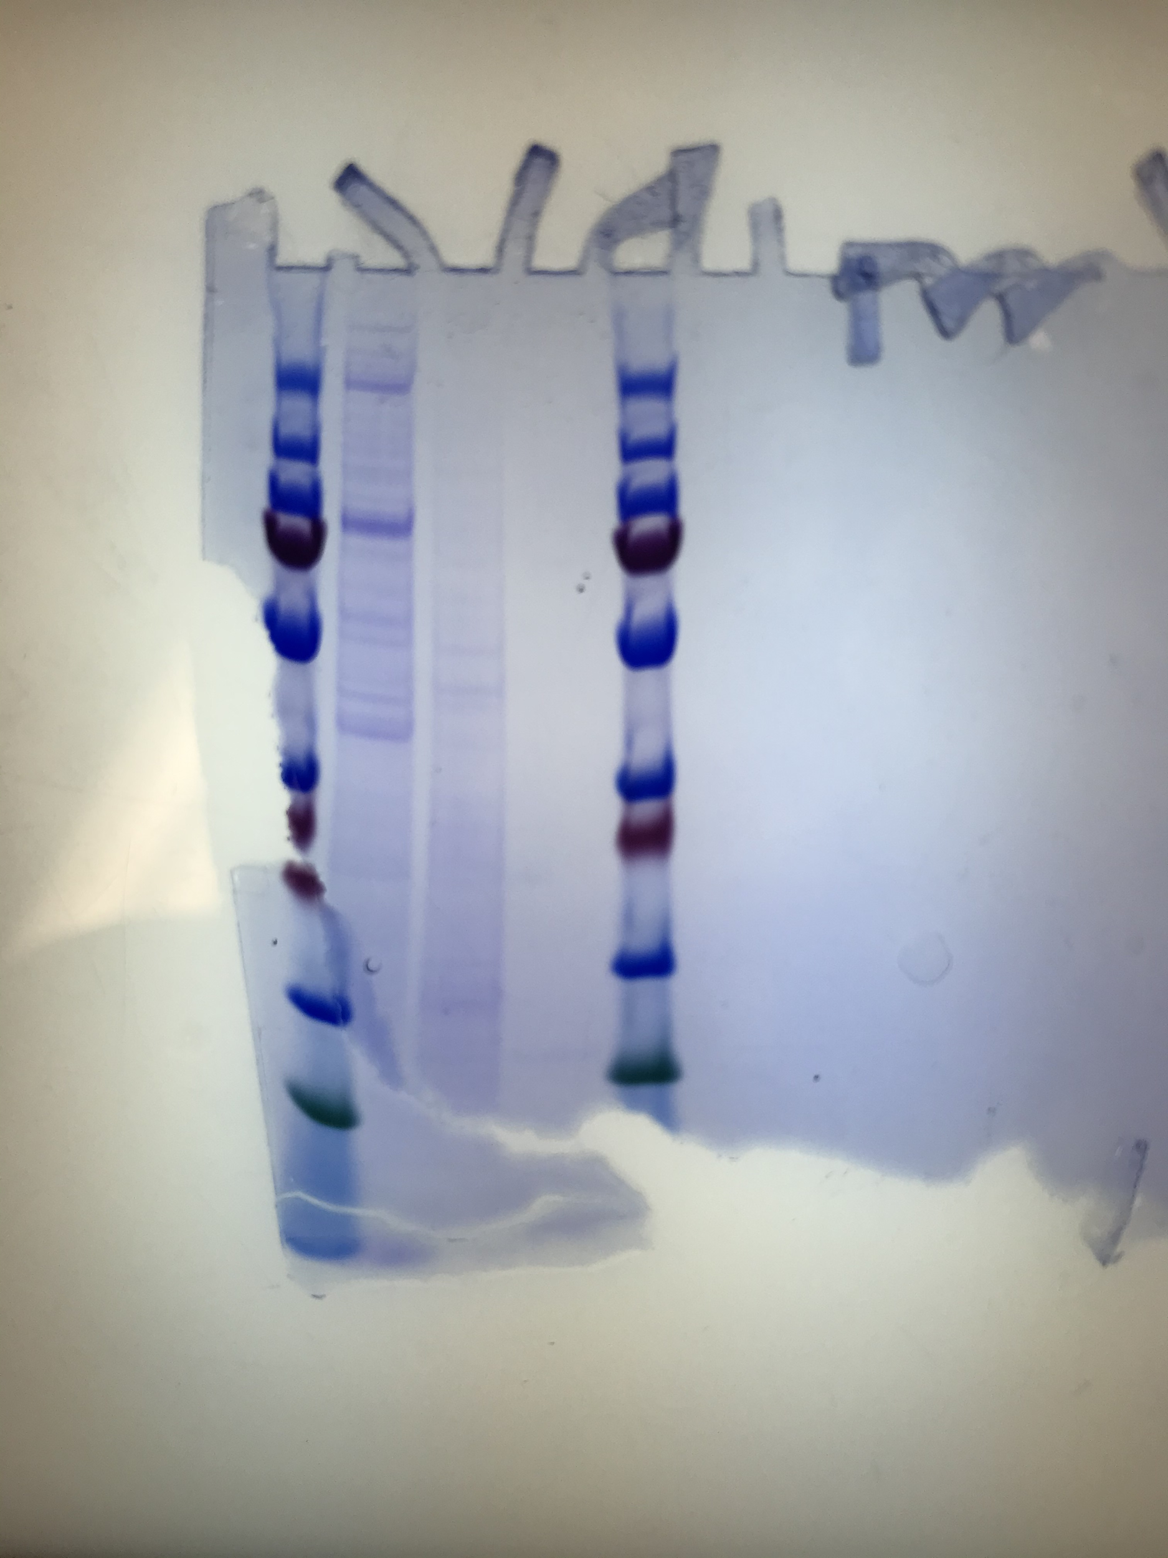
MOSQUITO STUDY by Estevan
Below is the gel from our control group, and compared to the protein ladder we can see that there are two very distinguishable markers at approximately 250 kDa and 90 kDa. These are the markers that we will be looking for in the experimental group.
Below is the gel from our experimental group. Our bands that we were observing are still visible however it seems that there are many more bands present after flight.

Slide 10
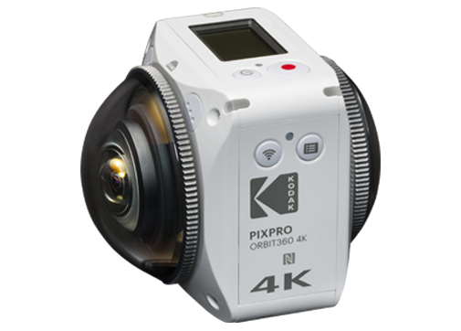
Kodak Orbit360 4K Camera
Our team decided to attach a 360 camera to the payload which will offer a VR experience of the launch. This camera was chosen for its size and performance.
Kodak Orbit360 Specs:
360° Spherical/VR Mode (Lens A & B) 27MP: (2:1) 7360x3680, 15MP: (2:1) 5520x2760; Dual Dome (Lens A & B) (2:1)27MP: 7360x3680, (2:1) 15MP: 5520x2760
Bluetooth 4.1
Rechargable Li-ion Battery, 3.6V 1250mAh
Splashproof, Shockproof, Freezeproof and Dustproof
Final weight of 5.5 OZ

Slide 11
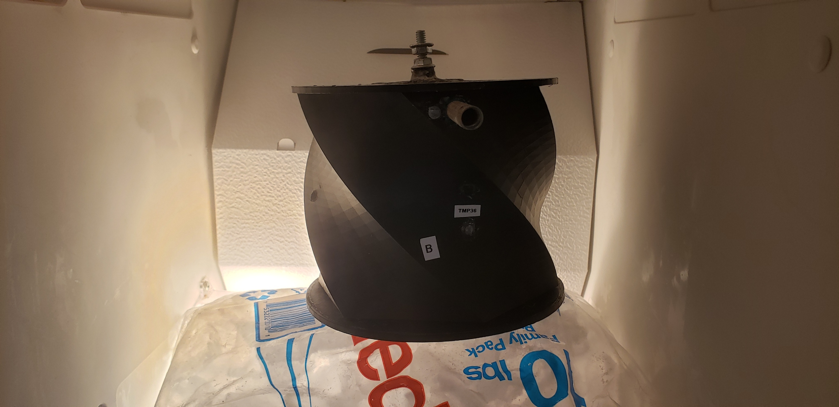
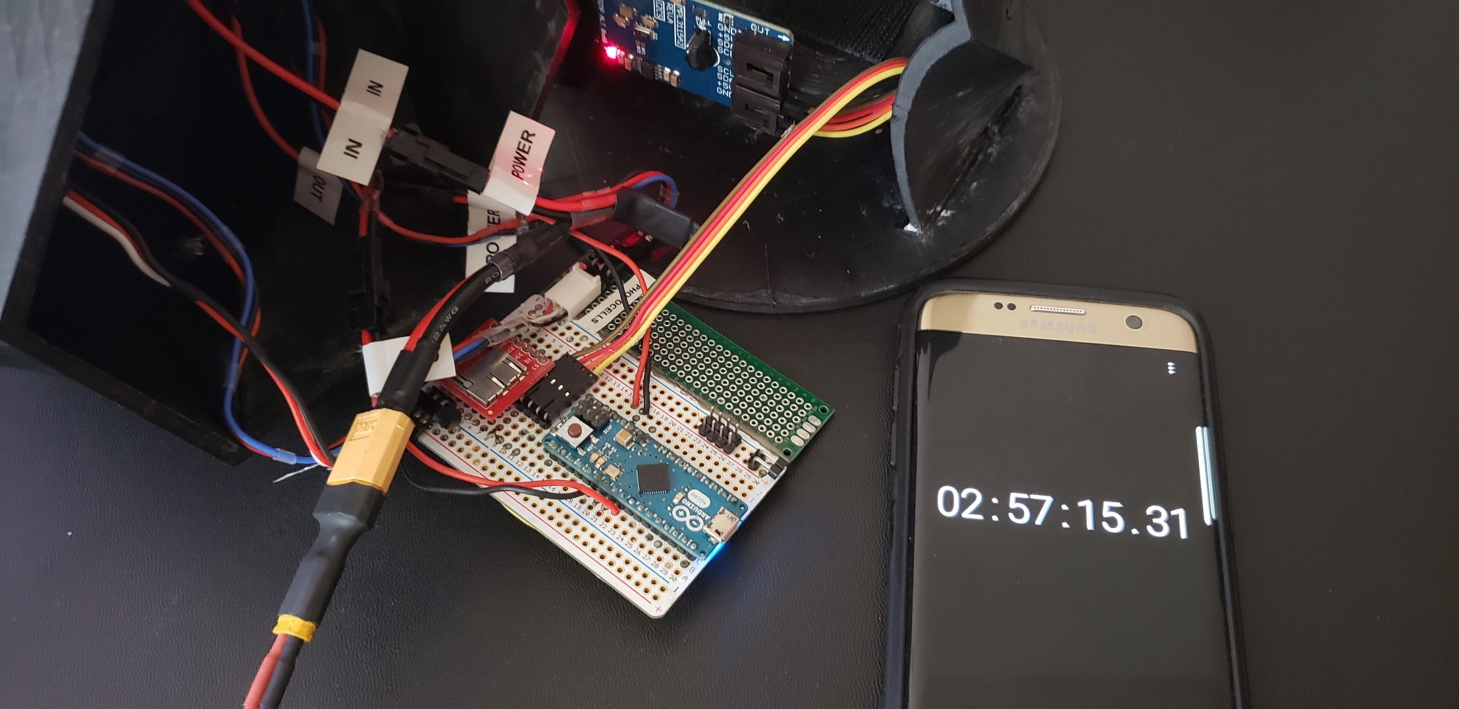
PAYLOAD TESTING PROCESS
During the testing process, the electronics and structural integrity of the payload capsule were stressed.
The electronics were testes for;
Run time
Temperature and environmental changes
Combination of runtime and temperature changes
The payload capsule itself was tested for;
Capsule strength
Shock absorption
Temperature and environmental changes
Testing payload’s functionality in freezer
Testing battery and runtime of electronics

Slide 12
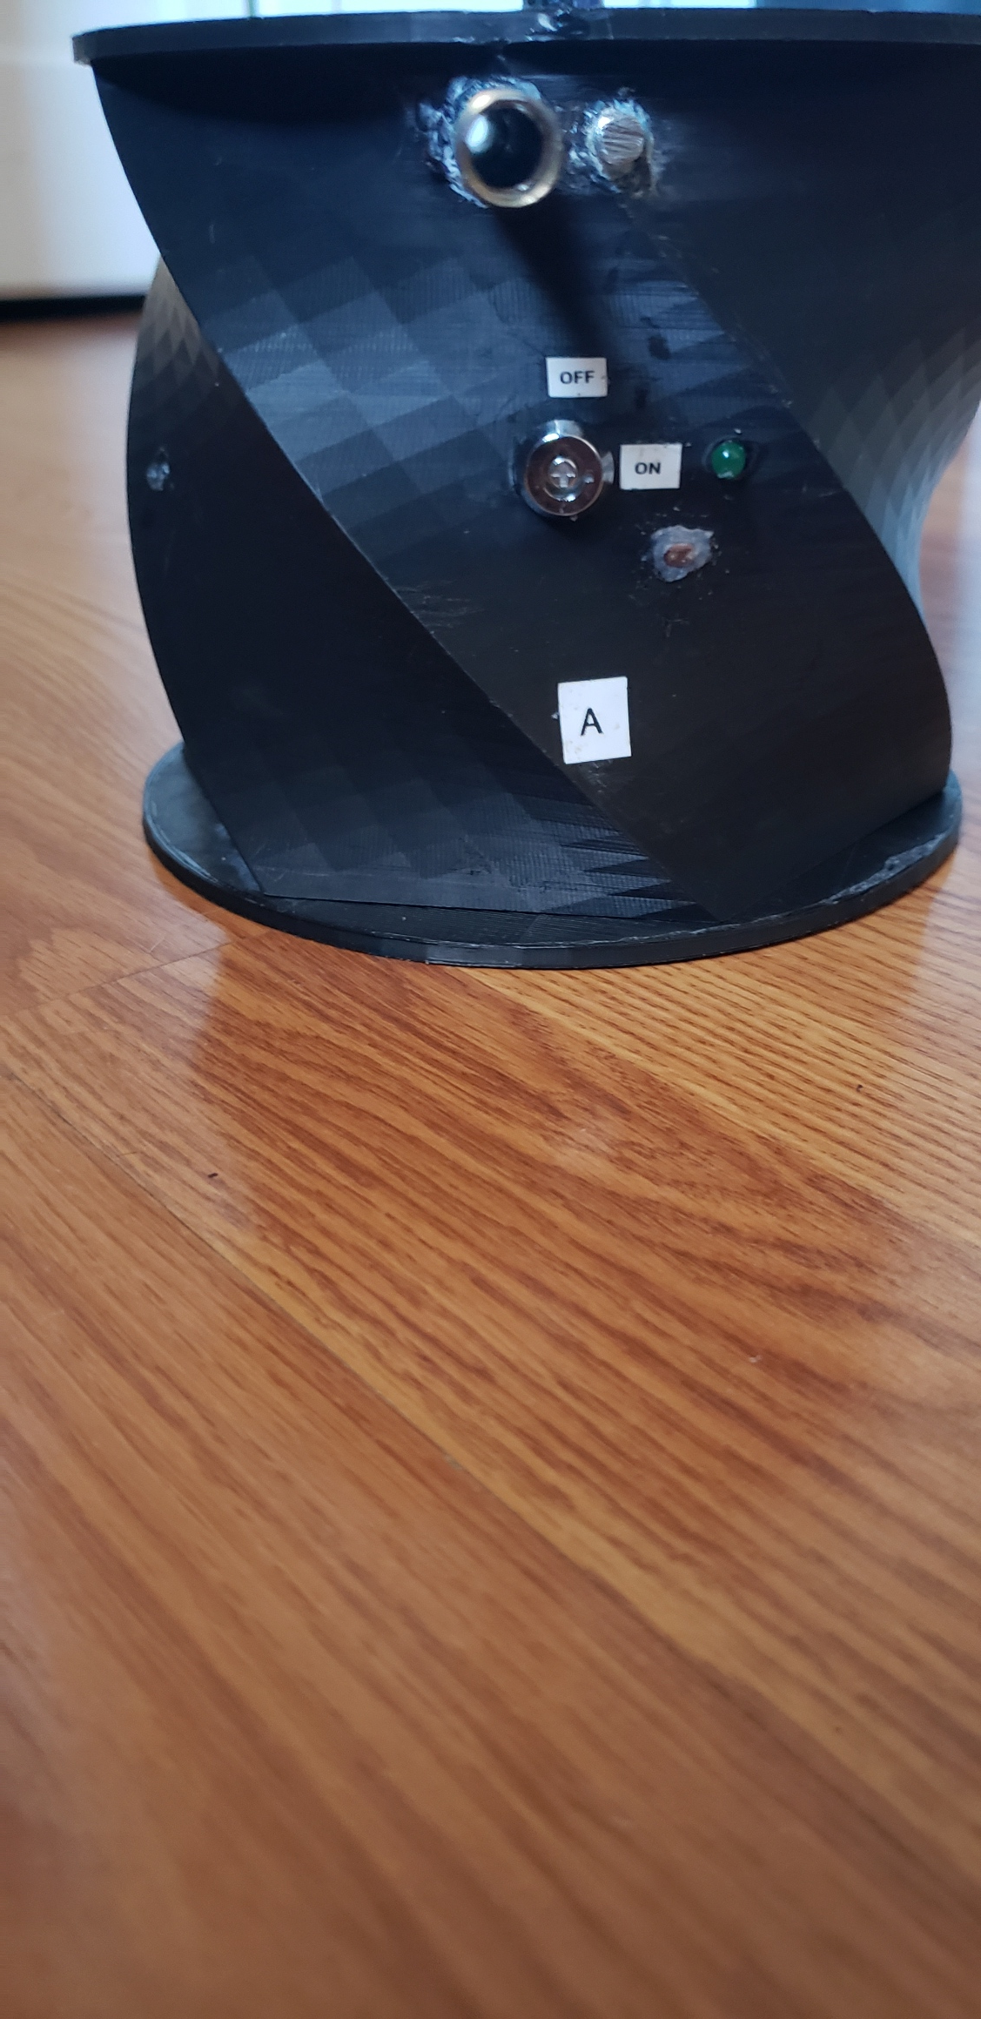
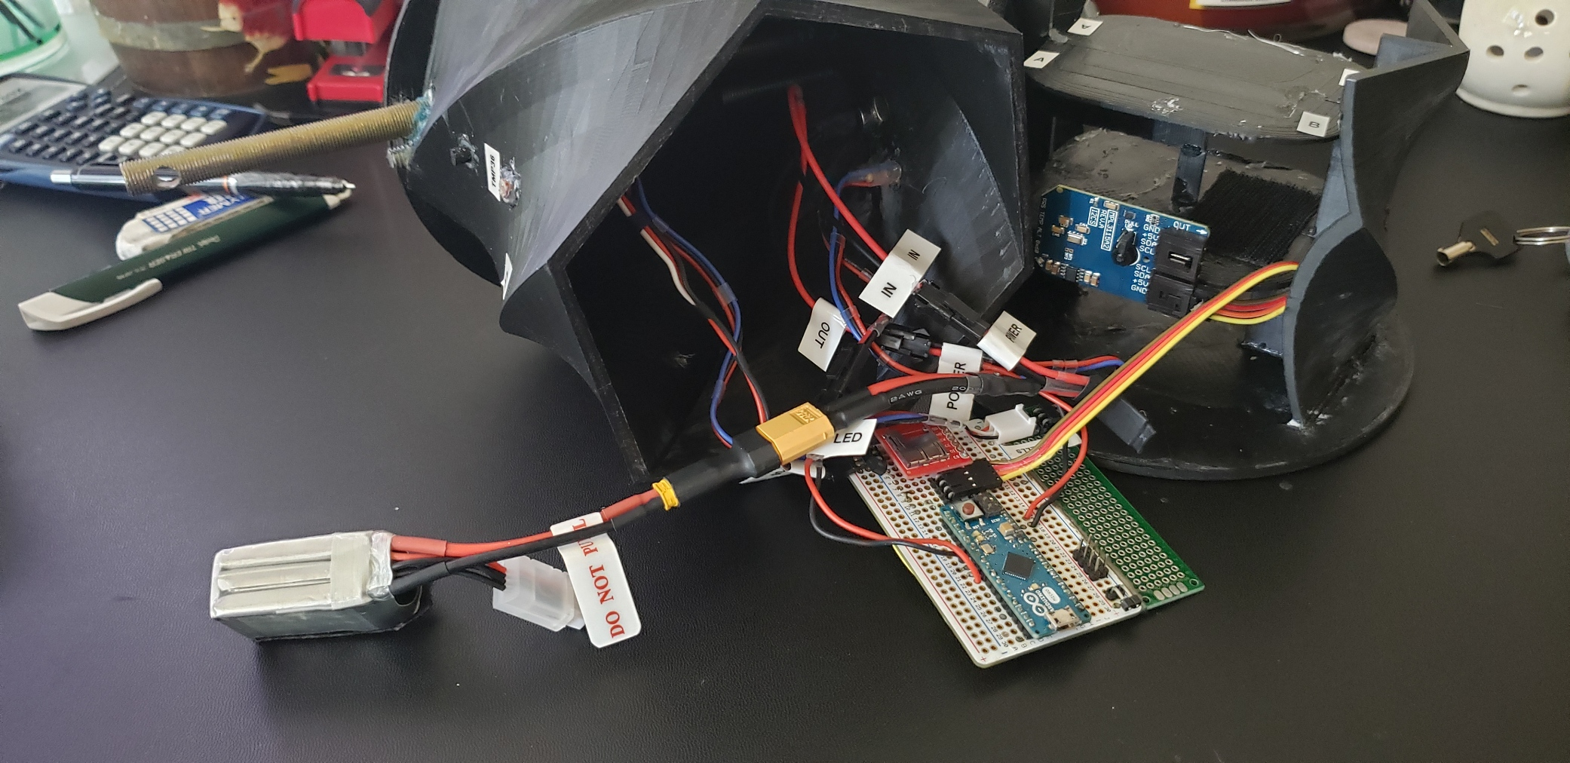
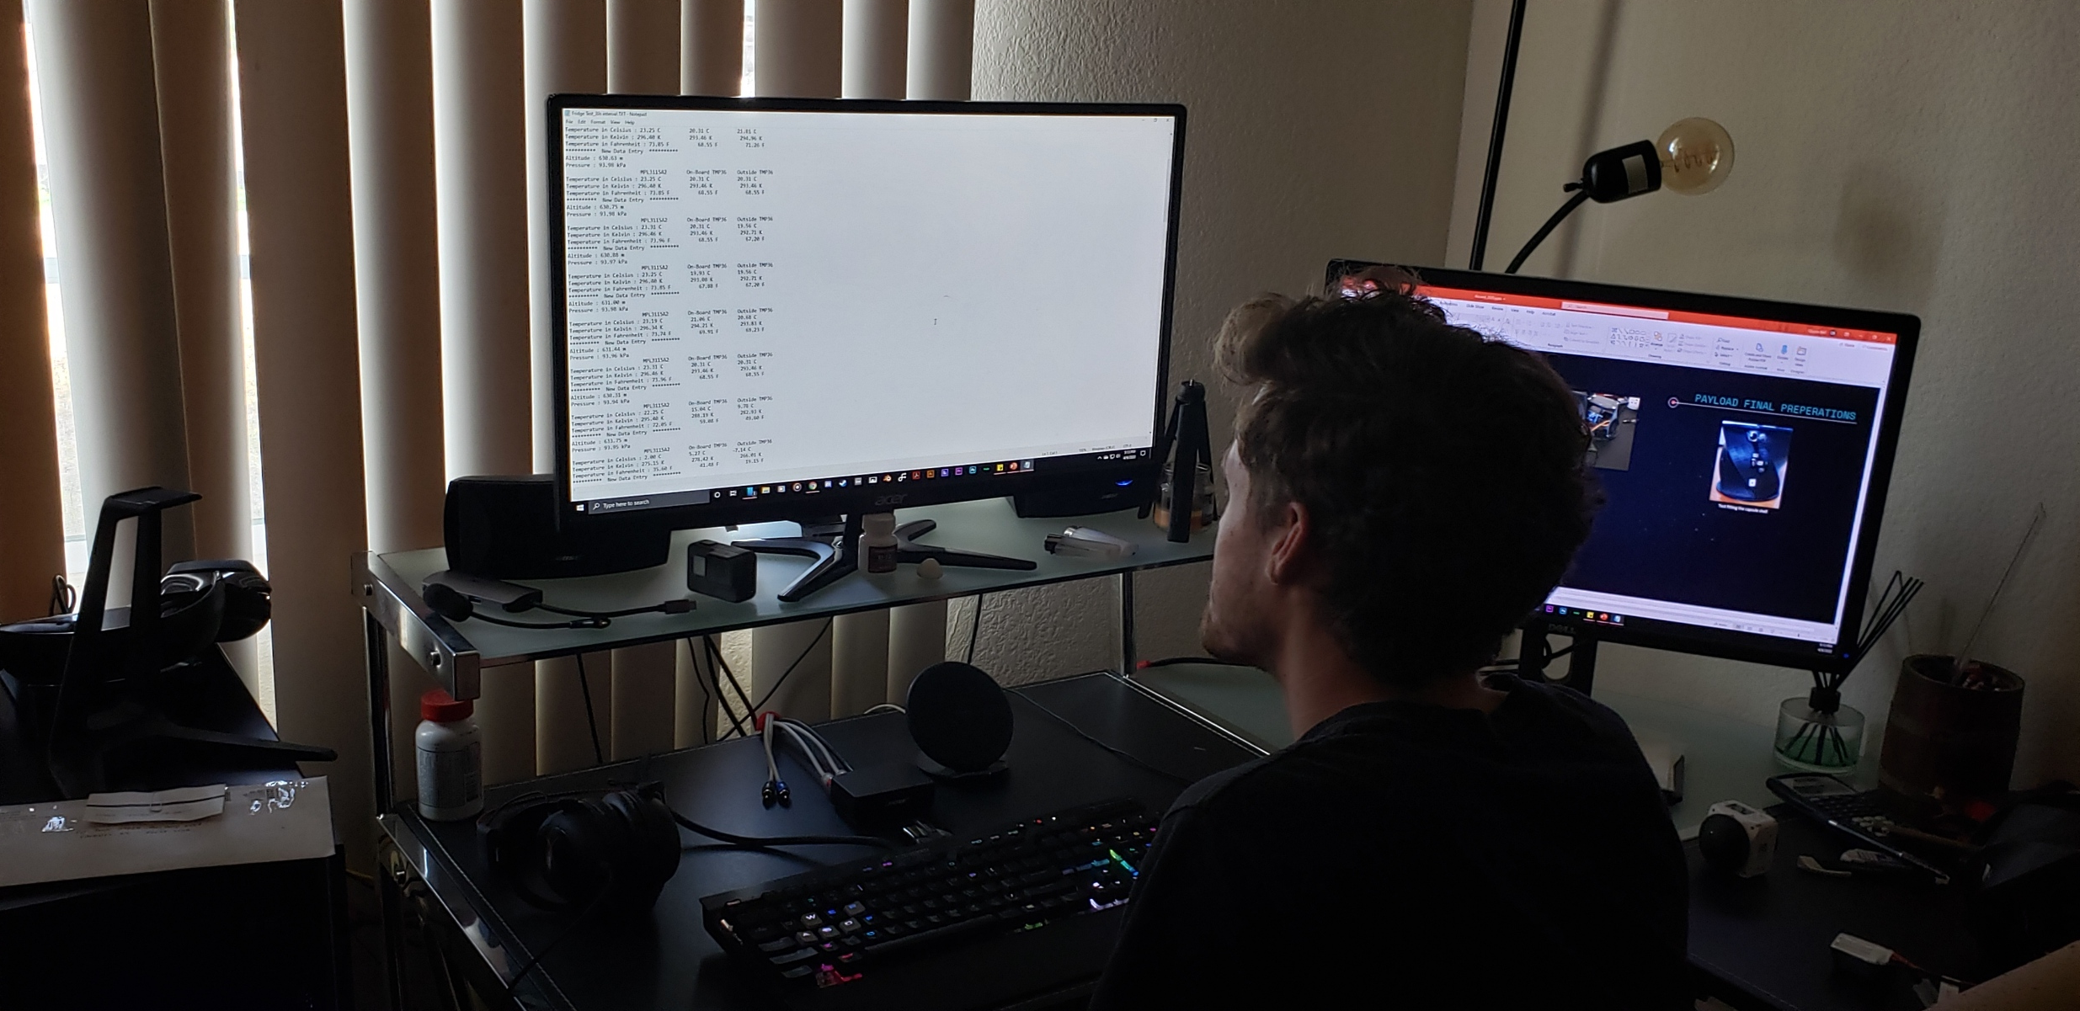
PAYLOAD FINAL PREPERATIONS
Test fitting the capsule shell
Fully finished payload ready for launch
Quynn reviewing test data

Slide 13
Thank You Any Questions Or Comments?

